Slide 1

STOCK PRICE PREDICTION USING K-NEAREST NEIGHBOUR(KNN)
MIS 6356 - BA WITH R
GROUP 12
LAKSHIT RAJPUT
ANIRUDH MANDAVA
M V B PRANEETH REDDY

Slide 2
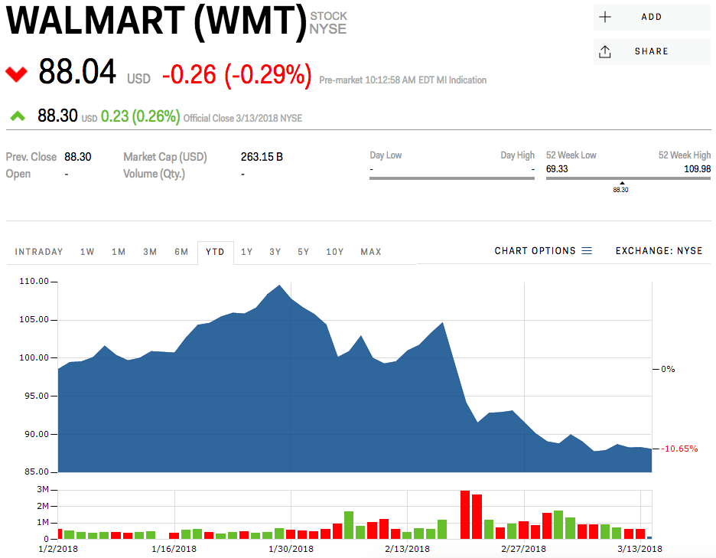
INTRODUCTION
A stock market is a public market for the trading of company stock.
Stock market allows us to buy and sell units of stocks (ownership) of a company.
If the company’s profits go up, then we own some of the profits and if they go down, then we lose profits with them.
So its necessary to predict the trend of the stocks price.

Slide 3
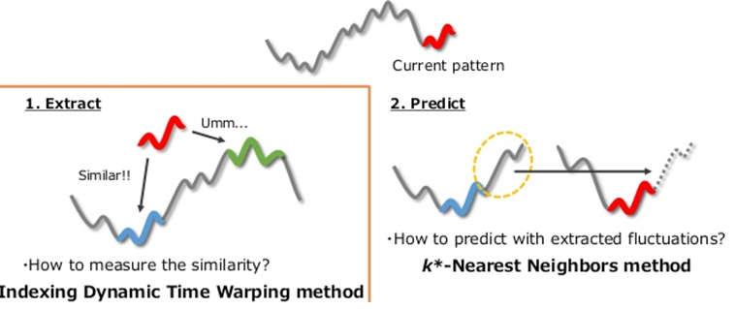
INTRODUCTION
Here we applied k-nearest neighbor algorithm in order to predict stock prices for a sample of seven major companies listed on the NASDAQ stock market to assist investors, management, decision makers, and users in making correct and informed investments decisions.
According to the results, the kNN algorithm is mildly robust with a good accuracy; consequently the results were rational and reasonable.

Slide 4
PROCEDURE
Important variables that effect stock movement
Variable | Description
Price | Current Price
Open | Opening price of a stock for the day
Close | Closing price of a stock for the day
High | Highest price of a stock for the day
Low | Lowest price of a stock for the day

Slide 5
PROCEDURE
In stock predictions, a set of pure technical data, fundamental data, and derived data are used in prediction of future values of stocks.
The pure technical data is based on previous stock data while the fundamental data represents the company's’ activity and the situation of market.
When we combine these information about a company and its stock, we assume that we should be able to yield a prediction of the future price of the stock.
In classification approaches using machine learning algorithms, a data set is divided into training data set and testing set.
kNN uses similarity metrics to compare a given test entity with the training data set. Each data entity represents a record with n features.
In order to predict a class label for unknown record, kNN selects k records of training data set that are closest to the unknown records

Slide 6
PROCEDURE
Steps we used to perform kNN are:
Handle data: Get data using yahoo finance and save and the load the dataset from CSV and split into test/train datasets.
Similarity: Calculate the distance between two data instances
Neighbors: Locate k most similar data instances
Response: Use a majority vote for the class labels of k nearest neighbors and generate a response from a set of data instances
Accuracy: Summarize the accuracy of predictions
Main: Tie it all together

Slide 7
MATHEMATICAL CALUCLATIONS AND VISUALIZATION MODELS
ACCURACY
Since there are only two possible outcomes of the process, so we directly compare the predicted outcome with the actual outcome to calculate the accuracy of the model.
We can see this implemented Accuracy code.
VISUALIZTION
For visualization, we have constructed a graph, for each stock, that shows the actual stock prices on a given day with the prediction for that day.

Slide 8
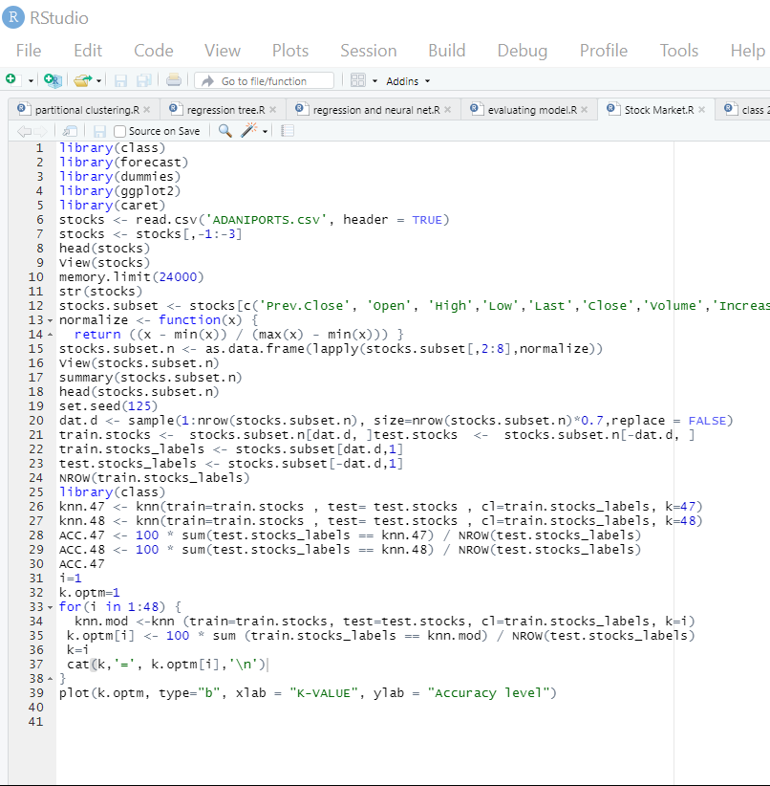
.R CODE

Slide 9
SAMPLE DATA SETS RESULT
STOCK | ACCURACY%
ADANI PORTS | 41.9%

Slide 10
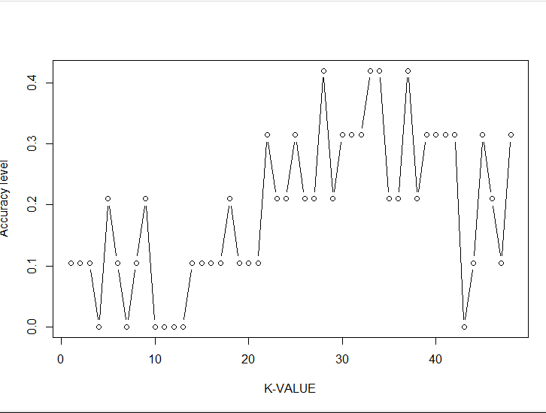
PLOTTING BETWEEN K VALUE AND ACCURACY LEVEL

Slide 11
CONCLUSION
Investors can make a lot of money by analyzing the last five company’s stock prices. A stock represents equity which has a very higher rate of return so the investor can think of investing in a company with a profound knowledge compared to bond or investing in land etc. Stocks are volatile which gives authority to the investor to sell them off at any point.

